Slide 1
Object-oriented Programming
Week 12

Slide 2
Abstract Class
There are cases in which it’s useful to define classes that are never instantiated. Such classes are called abstract base classes or simply abstract classes
Abstract base classes are incomplete — derived classes must define the “missing pieces”

Slide 3
Abstract Class
An abstract class provides a base class from which other classes can inherit
Classes that can be used to instantiate objects are called concrete classes
An abstract can inherit another abstract class

Slide 4
Example
Suppose that we have an application that works with 2D shapes
We have a class called 2D with a function draw(). But… what shape would the function draw? Should draw() be implemented in base class??
We can extend the class with derived classes such as Square, Triangle & Circle. And provide implementation for draw()

Slide 5
Abstract Class
Abstract base classes are too generic to define real objects
Concrete classes provide the specifics that make it reasonable to instantiate objects

Slide 6
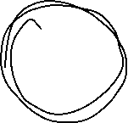

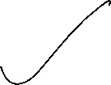

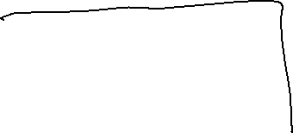
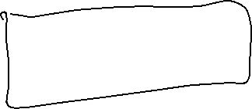


Pure Virtual Functions
A class is made abstract by declaring one or more of its virtual functions to be “pure”
A pure virtual function is specified by placing “= 0” in its declaration
Example: virtual void draw() = 0;

Slide 7
Virtual vs Pure Virtual
A virtual function has an implementation in the base class; a pure virtual function does not have an implementation in the base class
Virtual functions can be overriden by the derived classes; pure virtual functions must be overriden by the derived classes

Slide 8





A class is abstract if it has at least one pure virtual function.
class Base{
int x;
public:
virtual void fun() = 0;
int getX() {
return x; }};
// This class inherits from Base and implements fun()
class Derived: public Base{
int y;
public:
void fun() { cout << "fun() called"; }};
int main(void){
Derived d;
d.fun();
return 0;}

Slide 9
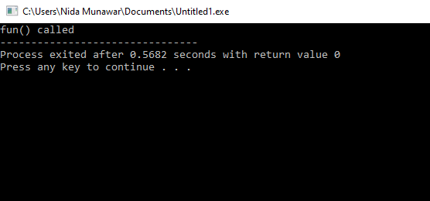

Slide 10




We can not instantiate an abstract class
#include<iostream>
using namespace std;
class Test{
int x;
public:
virtual void show() = 0;
int getX() {
return x; }};
int main(void){
Test t;
return 0;}

Slide 11


Slide 12
Abstract Class
Although we cannot instantiate objects of an abstract base class, we can use the abstract base class to declare pointers and references that can refer to objects of its derived class
Abstract classes support the principle of Polymorphism

Slide 13









We can have pointers and references of abstract class type.
class Base{
int x;
public:
void getX() { cout << "In Base \n"; }
virtual void show() = 0;};
class Derived: public Base{
public:
void show() { cout << "In Derived \n"; }};
int main(void){
Base *bp = new Derived();
bp->show();
bp->getX();
return 0;}

Slide 14
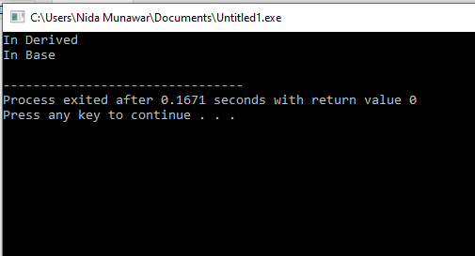
We can have pointers and references of abstract class type.

Slide 15



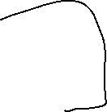



If we do not override the pure virtual function in derived class, then derived class also becomes abstract class.
class Base{
public:
virtual void show() = 0;};
class Derived : public Base { };
int main(void){
Derived d;
return 0;}

Slide 16


Slide 17


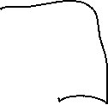



class Base{
public:
virtual void show() = 0;};
class Derived : public Base { };
class Derived1 : public Derived {
public:
void show() {
cout<<"show method implementation \n";} };
int main(void){
Derived1 d;
d.show();
return 0;}

Slide 18
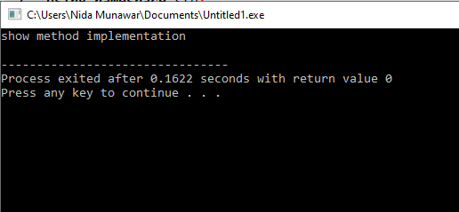

Slide 19


An abstract class can have constructors.
class Base{
protected:
int x;
public:
virtual void fun() = 0;
Base(int i) {
x = i;
cout<<"Constructor of base called\n"; }};
class Derived: public Base{
int y;
public:
Derived(int i, int j):Base(i) { y = j; }
void fun() { cout << "x = " << x << ", y = " << y<<'\n'; }};

Slide 20

An abstract class can have constructors.
int main(void){
Derived d(4, 5);
d.fun();
//object creation using pointer of base class
Base *ptr=new Derived(6,7);
ptr->fun();
return 0;}

Slide 21
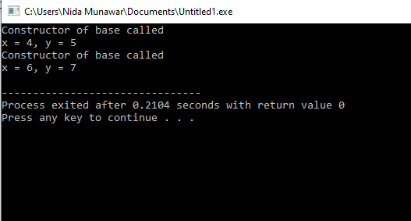
An abstract class can have constructors.

Slide 22
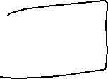
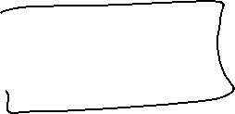
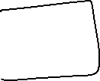

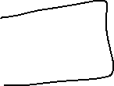
Case Study

Slide 23
A company pays its employees weekly.
The employees are of four types: Salaried employees are paid a fixed weekly salary regardless of the number of hours worked, hourly employees are paid by the hour and receive overtime pay for all hours worked in excess of 40 hours, commission employees are paid a percentage of their sales and base-salary-plus-commission employees receive a base salary plus a % of their sales. For the current pay period, the company has decided to reward base-salary-plus-commission employees by adding 10 percent to their base salaries.

Slide 24
Next Lecture
Revision

